Slide 1


UTA EE Labs
Controlling you Arduino with Bluetooth

Slide 2


Slide 3
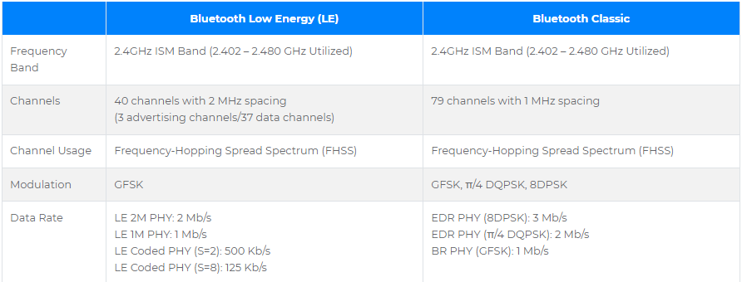
Differences in BT v BLE

Slide 4
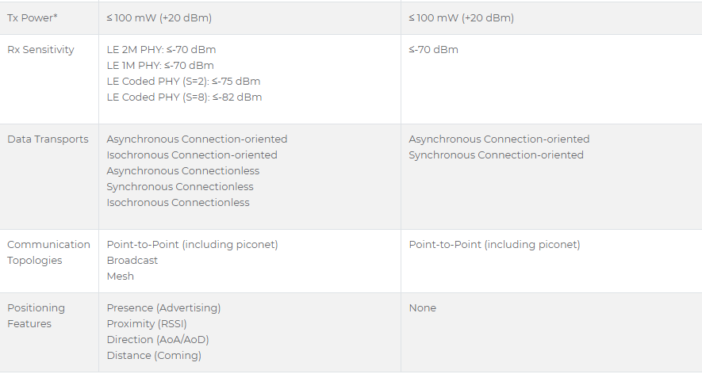
Differences in BT v BLE

Slide 5
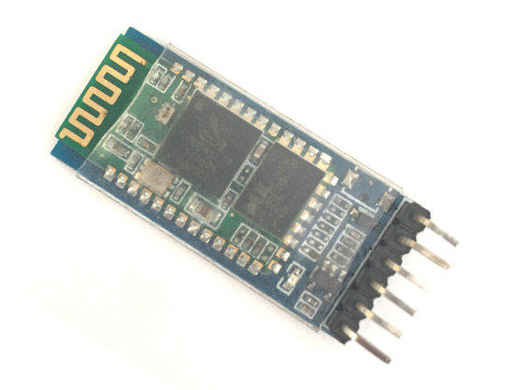
HC-05 Bluetooth module
Uses Bluetooth 3.0
iPhone does not support BT 3.0
Try using HC-10 which has BT 4.0 BLE

Slide 6
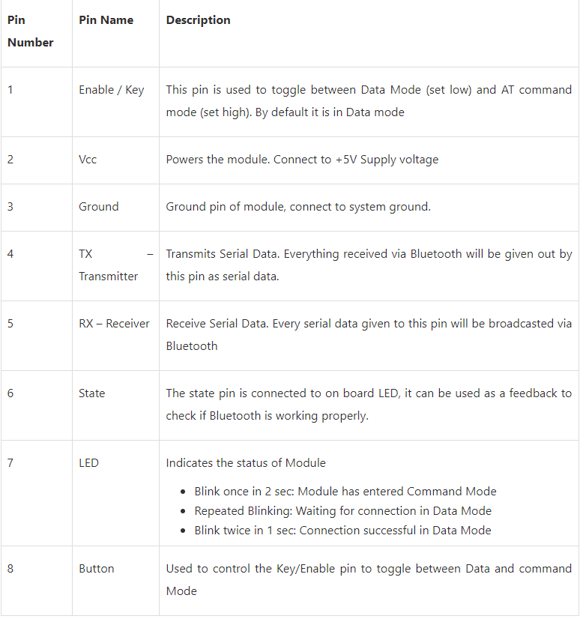
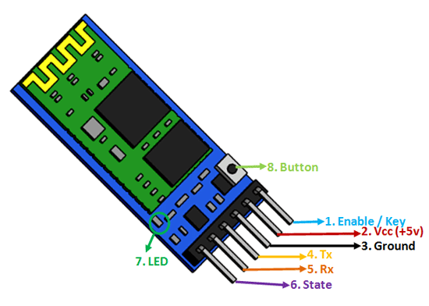

Slide 7
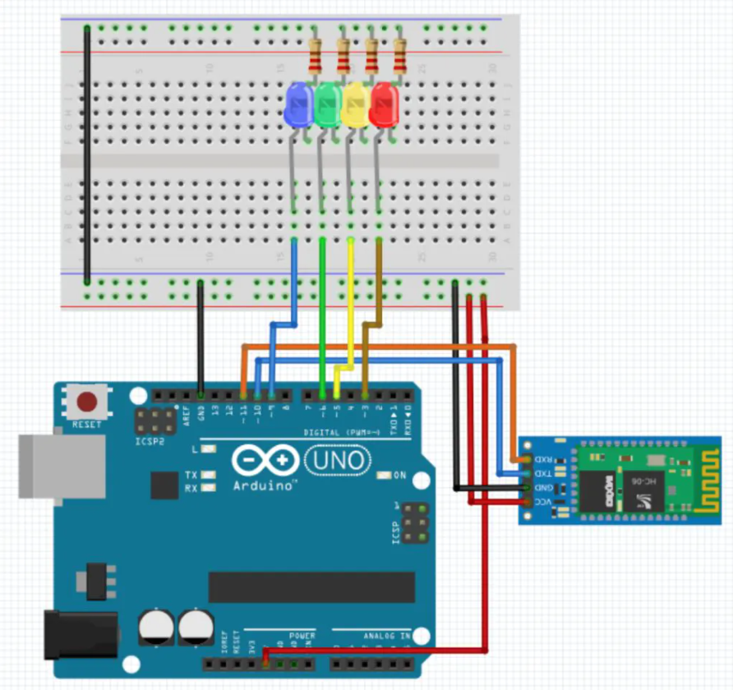
Let’s Create
You can put the HC-05 on the breadboard and just use male to male jumpers.

Slide 8
One more wire
KEY: This pin has to be pulled high to enter AT mode.
Add a jumper from the 5V line to the Enable / Key pin on the HC-05

Slide 9
Let’s Code
Download SoftwareSerialExample.ino from the UTA EE Lab Git hub page
https://github.com/EELabMan/UTA-EE-Workshops/tree/main/SoftwareSerialExample/SoftwareSerialExample

Slide 10
AT Commands
The HC-05 must be set to AT mode before you can use the AT commands.
If the LED on the HC-05 doesn’t blink 1 time every two seconds, remove the power to the HC-05, Press and hold the tiny button on the HC-05 and replace the power. This should set it in AT mode.
After you upload and open your serial monitor and set Both NL & CR and set the baud rate to 9600.
The response should be : OK

Slide 11
AT COMMANDS
Enter the following AT Commands
AT : Check the connection. AT+NAME : See default name AT+ADDR : see default address AT+VERSION : See version AT+UART : See baudrate AT+ROLE: See role of bt module(1=master/0=slave) AT+PSWD: see default password

Slide 12
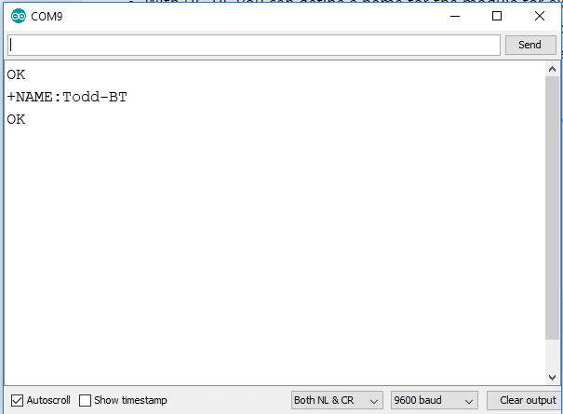
Set a new Name for the HC-05
Type AT+NAME:XXX - XXX is any short name you want.
Should return OK
Type AT+NAME to confirm new name.

Slide 13
How to Change the Pin
We will keep the default password (PIN Number) for this workshop
AT + PSWD xxxx where 'xxxx' will be 4 numbers.
Enter AT+PSWD:1234
Enter AT+PSWD to confirm the new Pin Number

Slide 14
Data Mode
Unplug the Arduino and remove the 5 volt wire going to the Key pin on the HC-05
Open a new sketch in the Arduino IDE.
Copy the Phone_control_via_BT.ino Arduino Code from https://github.com/EELabMan/UTA-EE-Workshops into the sketch
Plug in the arduino

Slide 15
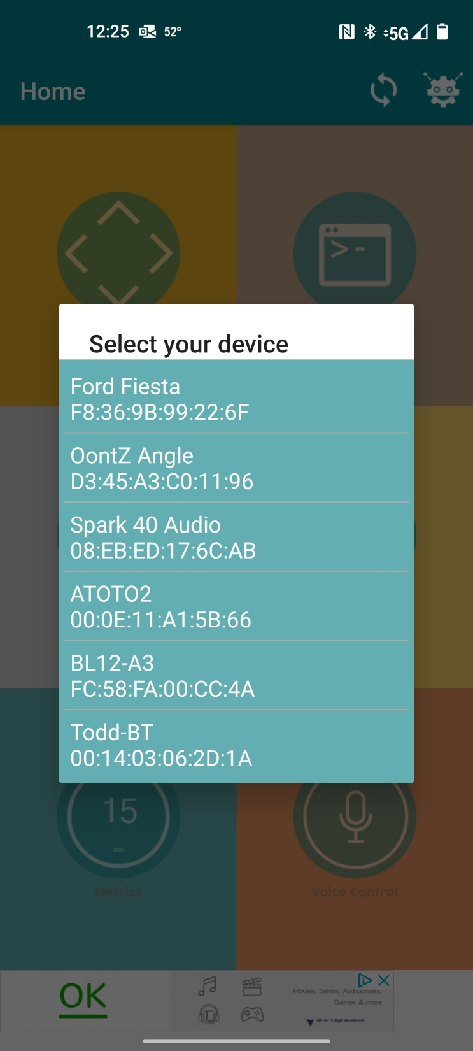
Android app
First open settings and Bluetooth and pair your phone to the HC-05. It will be listed under the name you gave it.
Search the Play store for Arduino BlueControl and install.
Open it and press the circle arrows to search for the name of the HC-05

Slide 16
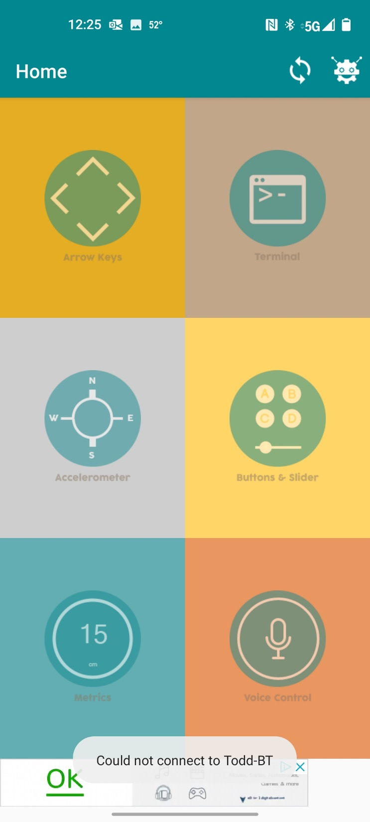
Setting up Arduino BlueControl
It is a little buggy, but it works.
Let’s add the code to turn on the buttons.
Press the little germ with antennas on it

Slide 17
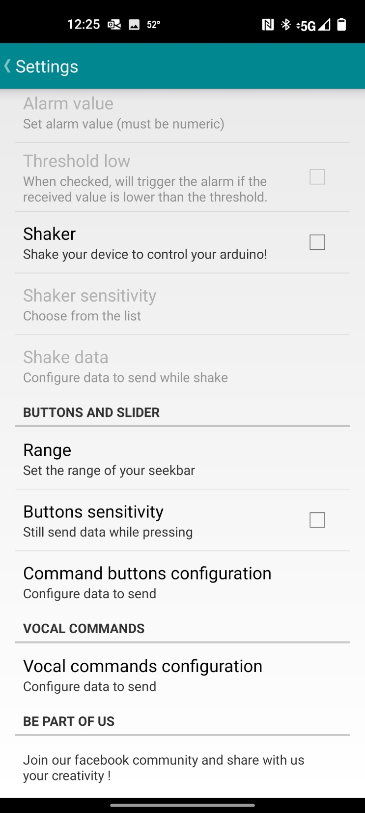
Setting up Arduino BlueControl
Scroll down and select Command Button Configuration.

Slide 18
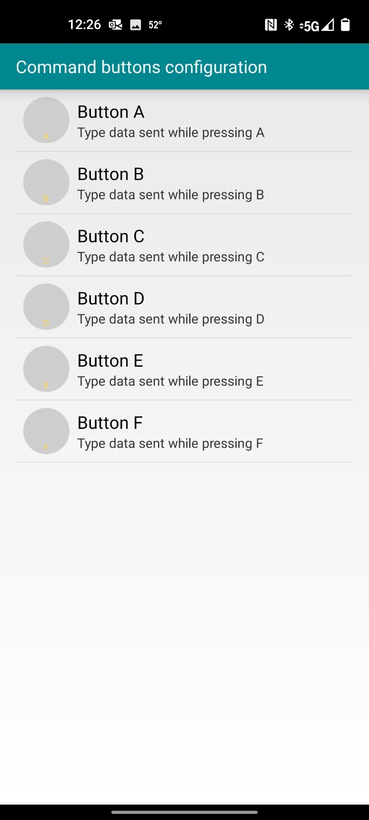
Setting up Arduino BlueControl
Press Button A

Slide 19
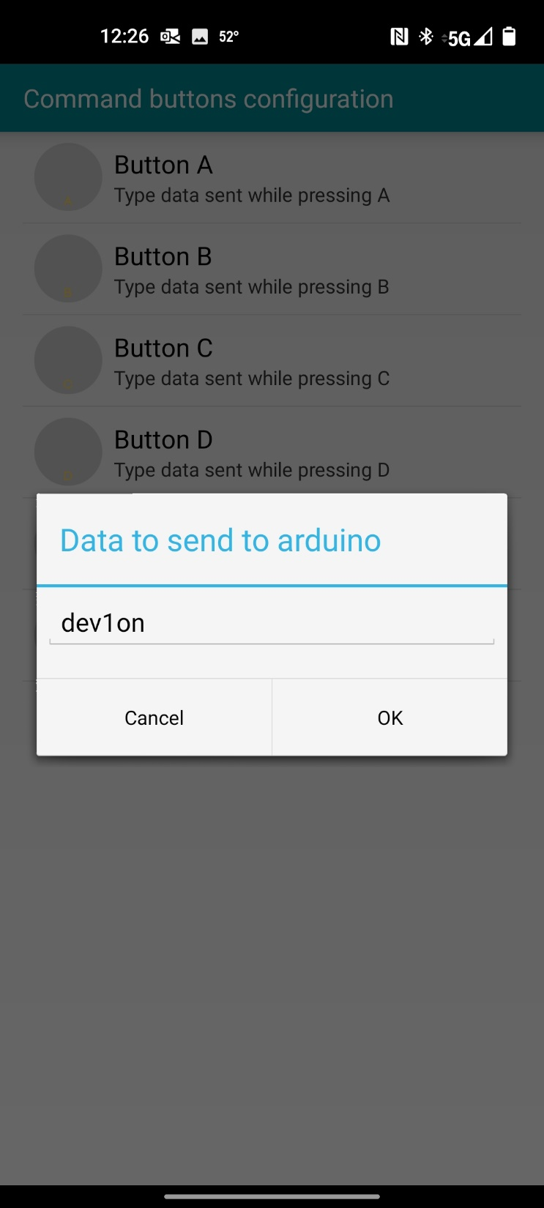
Setting up Arduino BlueControl
Enter dev1on and press ok.

Slide 20

Setting up Arduino BlueControl
Set button B to dev2on
Set Button C to dev3on
Set Button D to dev4on
This only leaves 2 more buttons to turn the led’s off so we will add them to a different menu.
My phone does not have a back button from this menu – So shut the program down and reopen it.

Slide 21
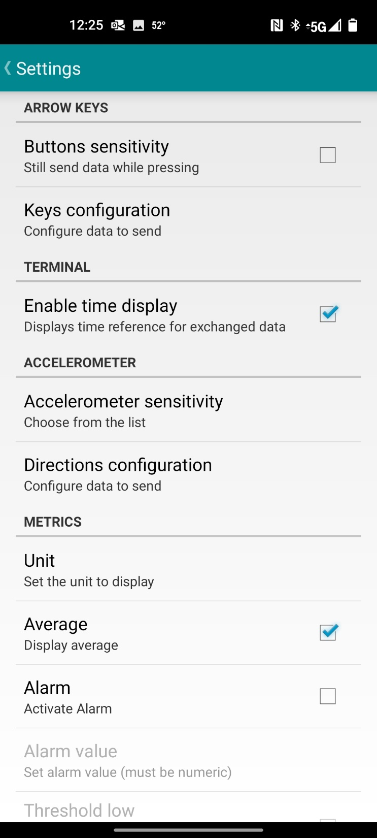
Setting up Arduino BlueControl
This time go into settings and select the arrow keys -> Keys Configuration

Slide 22
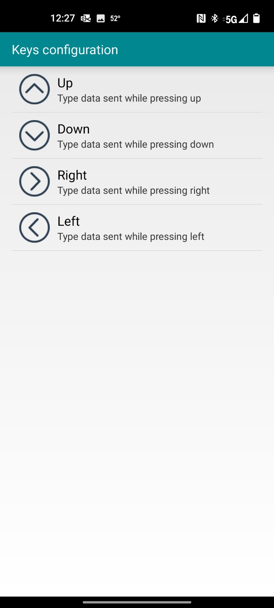
Setting up Arduino BlueControl
Set the up to dev1off
Set the down to dev2off
Set the Right to dev3off
Set the left to dev4off
Again you may have to close the program and restart.

Slide 23
Setting up Arduino BlueControl
Now you should be able to turn on the LED’s in the buttons menu and turn them off with the Arrow keys.

Slide 24
Setting up Voice Control
Let’s add Voice control
In the settings scroll to Vocal commands Configuration.

Slide 25
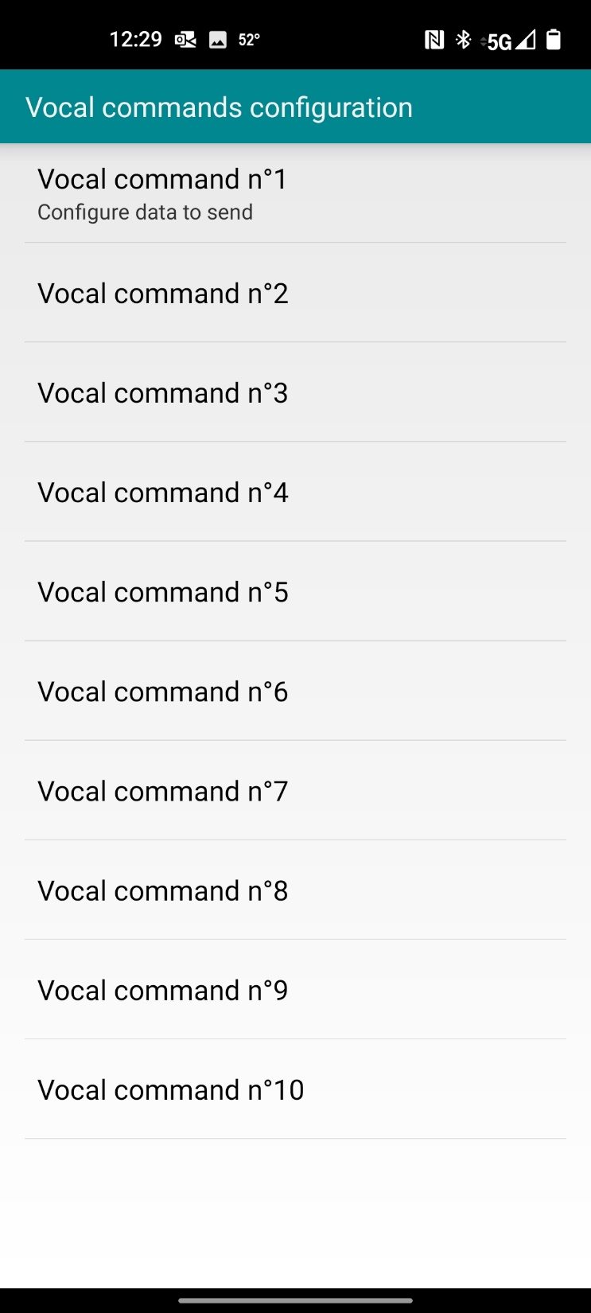
Setting up Voice Control
There are up to 10 voice commands you can set.
Select the Vocal command No1

Slide 26
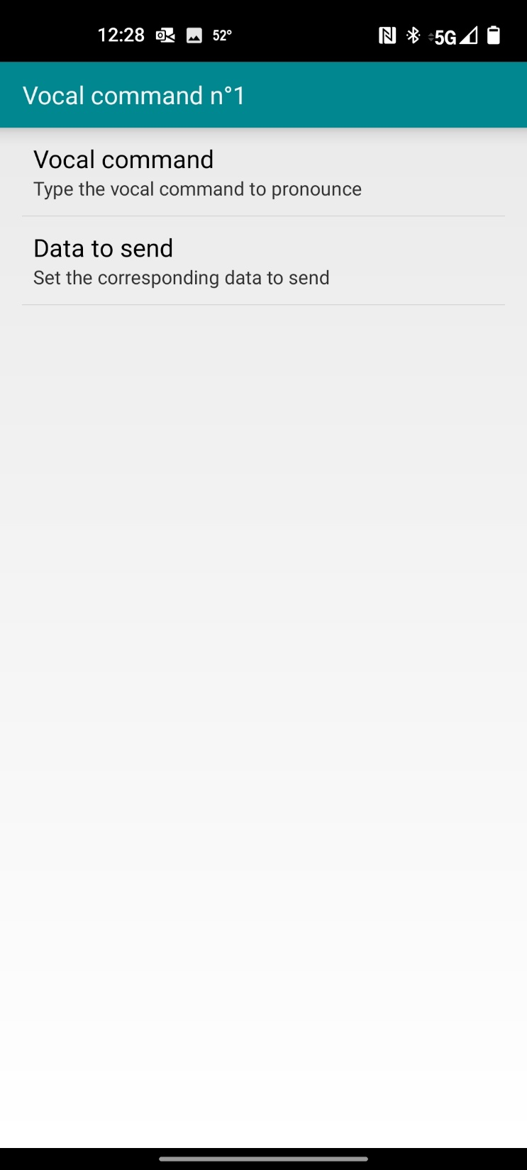
Setting up Voice Control
Select Vocal command
And input: Turn the red LED on
Save it and enter dev1on in data to send
Reboot program

Slide 27

Setting up Voice Control
Select Vocal command No2
And input: Turn the red LED off
Save it and enter dev1off in data to send
Reboot program

Slide 28
Setting up Voice Control
Try activating the Red led with your voice.

Slide 29
Accelerometer
Try to configure the settings to use the accelerometer to turn on and off two of the led’s.

